Slide 1




MEMORY MANAGEMENT:
GARBAGE COLLECTION AND RUST'S OWNERSHIP MODEL
Understanding Different Approaches to Memory Safety
Page 01

Slide 2

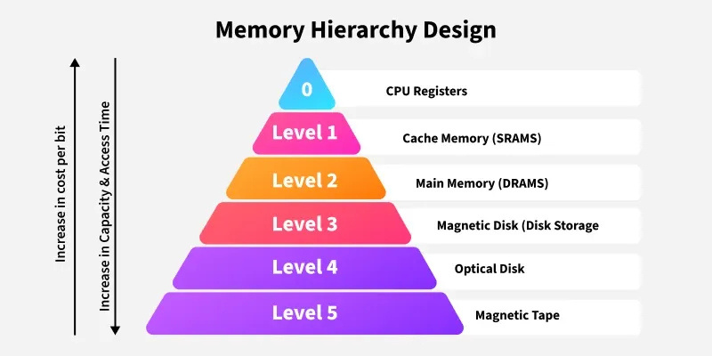
INTRODUCTION TO MEMORY MANGAMENT
DEFINITION: COORDINATION MEMORY ALLOCATION/DE-ALLOCATION BETWEEN PROGRAMS
Key Objectives:
Process Isolation(Security)
Efficient resource utilization
Performance Optimization
Page 02

Slide 3

MEMORY MANAGEMENT TECHNIQUES
Technique | Pros | Cons | Use Case
Manual | Full Control | Error-Prone | Embedded-Systems
Garbage Collection | Automatic | Overhead | Java/Python
Rust Ownership | Safe+perfomant | Steep Learning Curve | Systems Programming
Page 03

Slide 4
MANUAL MEMORY MANAGEMENT (CODE)
// C example
int* arr = malloc(100 * sizeof(int));
if(arr == NULL) exit(1); // Critical check
free(arr); // Must explicitly free
arr = NULL; // Prevents accidental use of a dangling pointer
Key Points:
Risk: Memory leaks if free() omitted
Danger: Dangling pointers if freed memory accessed
Page 04

Slide 5
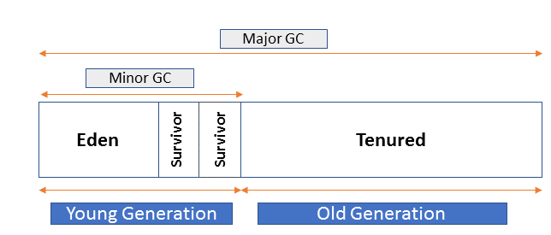
GARBAGE COLLECTION DEEP DIVE
1) Mark-Sweep (Basic Algorithm)
Mark Phase:Traverses object graphs starting from roots(globals,stack variables) and mark unreachable object
Sweep Phase: Clears unmarked
//JavaScript example (mark phase simulated)
let root={data:”root”}
let orphan={data:”unreachable”}
//Only ‘root’ is marked; ‘orphan’ is swept
2)Generational Collection
Heap Structure:
Young generation(Eden+Survivors): Short lived
objects(loop variables)
Old generation: Long lived objects(e.g. Caches)
Optimization:Frequent G.C. in young gen,rare in old gen
Page 05

Slide 6
GARBAGE COLLECTION DEEP DIVE
3)Reference Counting(Python Style)
Each object has a reference count, tracking the number of references pointing to it
When the reference count drops to zero, the object is considered garbage and can be collected
Languages: Python (though it also uses other techniques to handle circular references
#Python reference example
import sys
x=[]
print(sys getrefcount(x)) #output 2
Page 06

Slide 7
ADVANCED GC STRATEGIES & OPTIMIZATION
Advanced Garbage Collectors
a. G1 (Garbage First) GC (Java)
Splits heap into regions rather than generations.
Performs incremental compaction.
Reduces long pause times compared to CMS.
b. ZGC (Java 11+)
Ultra-low pause times (<10ms), scales with heap size.
Uses colored pointers to track object states.
c. Shenandoah GC (Java 12+)
Fully concurrent GC, reducing pause times.
Region-based like G1, but performs concurrent compaction.
d. Immix (Rust, Java)
Uses line-marking and bump allocation.
Hybrid approach between copying and mark-sweep.
Page 07

Slide 8
PERFORMANCE COMPARISON
Aspect | Garbage Collection (GC) | Manual Memory Management
Memory Allocation | Automatic memory allocation and cleanup. | Requires explicit allocation (malloc) and deallocation (free).
Performance Overhead | GC introduces runtime overhead due to collection cycles (e.g., GC pauses). | Faster execution as there is no runtime overhead for memory cleanup.
Safety | Prevents memory leaks and dangling pointers automatically. | Prone to errors like memory leaks and dangling pointers if not managed correctly.
Real-Time Suitability | Not ideal for real-time systems due to unpredictable GC pauses. | Suitable for real-time systems where precise control over memory is required.
Ease of Use | Simplifies development by automating memory management. | Requires careful programming and debugging to avoid errors.
Page 08

Slide 9
RUST OWNERSHIP MODEL
Rust’s ownership model ensures memory safety without needing a garbage collector. It helps prevent data races, dangling pointers, and memory leaks by enforcing strict rules at compile time.
Key Rules of Ownership
Each value in Rust has a single owner (a variable that controls the value).
When the owner goes out of scope, Rust automatically deallocates the value (no manual memory management needed).
Ownership can be transferred (moved) or temporarily borrowed to avoid unnecessary copies.
rust
fn main() {
let v = vec![1,2,3]; // Heap allocation
let v2 = v; // Ownership transfer
// println!("{:?}", v); // Compile error!
}
Page 09

Slide 10
BORROWING & LIFETIMES
1. Borrowing
Immutable Borrowing (&T) – Multiple read-only references allowed.
Mutable Borrowing (&mut T) – Only one mutable reference at a time.
Prevents data races and ensures safe memory access.
let mut s = String::from("Hello");
let r1 = &s; // Immutable borrow
let r2 = &mut s; // Error! Cannot have mutable + immutable at the same time.
2. Lifetimes
Ensures references remain valid and prevents dangling references.
'a (lifetime annotation) specifies how long a reference should live.
fn longest<'a>(s1: &'a str, s2: &'a str) -> &'a str {
if s1.len() > s2.len() { s1 } else { s2 }
}
Ensures s1 and s2 outlive the returned reference.
Page 10

Slide 11
GARBAGE COLLECTION (GC) VS RUST'S OWNERSHIP MODEL
Aspect | Garbage Collection (GC) | Rust Ownership Model
Safety Mechanism | Runtime checks to identify unreachable objects and clean them up. | Compile-time checks enforce ownership, borrowing, and lifetimes.
Performance Impact | Runtime overhead due to GC cycles, causing pauses. | No runtime overhead; memory is managed at compile time.
Ease of Use | Easier for developers as memory management is automated. | Steeper learning curve due to strict rules for ownership and borrowing.
Memory Leaks Prevention | Prevents leaks automatically unless circular references occur. | Guarantees no leaks or dangling pointers through strict compile-time checks.
Use Cases | Ideal for high-level applications (e.g., Java/Python). | Suitable for systems programming and performance-critical applications.
Page 11

Slide 12


VIRTUAL MEMORY SYSYTEM
Components of Virtual Memory System
1. Page Tables (Address Translation)
Maps virtual addresses to physical addresses by storing the page number → frame number mapping.
Used for memory isolation between processes, ensuring each process gets its own logical address space.
2. TLB (Translation Look aside Buffer)
High-speed cache that stores recently used virtual-to-physical address translations to speed up access.
Reduces page table lookups, improving CPU performance by minimizing memory access delays.
3. Demand Paging
Loads pages into memory only when needed, reducing initial memory allocation.
Uses page faults to bring missing pages from disk into RAM, optimizing memory usage but potentially slowing execution if too many page faults occur.
Page 12

Slide 13
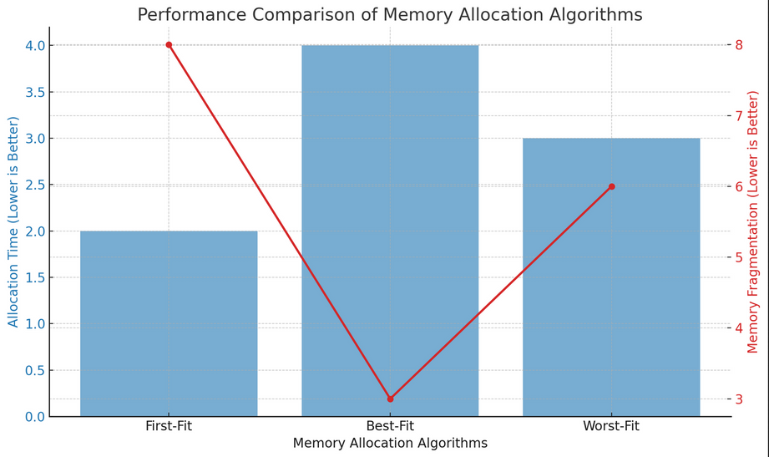
MEMORY ALLOCATION ALGORITHMS
First-Fit: Scans memory from the beginning and allocates the first available block that fits.
Best-Fit: Finds the smallest available block that fits the request.
Worst-Fit: Finds the largest block to leave the biggest remaining free space.
Page 13

Slide 14
MEMORY FRAGMENTATION
Memory Fragmentation:
Fragmentation occurs when memory is inefficiently utilized, leading to wasted space. It can be categorized into internal and external fragmentation.
1. Internal Fragmentation
Occurs within allocated memory blocks when a process is given more memory than it actually needs.
Example :If a 1025B process is allocated a 2048B block, 1023B remains unused
2. External Fragmentation
Occurs when free memory is split into small non-contiguous blocks, preventing larger allocations
Example: If memory has free blocks of 100B, 500B, 200B, but a request for 600B fails, even though 800B is free in total.
Page 14

Slide 15
OS MEMORY MANAGEMENT (LINUX EXAMPLE)
Content:
1) malloc() and System Calls (brk() / mmap())
malloc() dynamically allocates memory in user space.
It internally calls:
brk() → Expands/shrinks the heap for small allocations.
mmap() → Allocates large memory regions (e.g., for big arrays or shared memory)
2)Kernel allocators:
Buddy system (power-of-2 blocks):Splits memory into power-of-2 sized blocks (e.g., 4KB → 2KB → 1KB).
Slab allocator (object caching):Pre-allocates memory for frequently used objects (e.g., process control blocks).
Page 15

Slide 16
PERFORMANCE OPTIMIZATION
1. Cache Locality Principles
Spatial Locality → Data close together in memory is accessed together (e.g., arrays).
Temporal Locality → Recently accessed data is likely to be accessed again (e.g., loop variables).
2. False Sharing Prevention
False sharing happens when multiple threads modify variables in the same cache line, causing unnecessary cache invalidations.
Solution → Align frequently updated variables to separate cache lines to prevent conflicts.
3. Example: Padding in C Structs
#include <stdio.h>
struct AlignedStruct {
int x;
char padding[60]; // Ensures x and y are in different cache lines
int y;
};
int main() {
printf("Size of struct: %lu bytes\n", sizeof(struct AlignedStruct));
return 0;
}
Page 16

Slide 17
DEBUGGING MEMORY ISSUES
1. Valgrind (C/C++)
Detects memory leaks, invalid accesses, and uninitialized memory.
Commonly used tool: memcheck.
2. Rust’s Borrow Checker
Prevents memory leaks and unsafe memory access at compile time.
Enforces ownership, borrowing, and lifetimes.
3. GC Log Analyzers (Java)
Helps analyze Java Garbage Collection (GC) performance.
Detects memory leaks & excessive GC pauses.
Page 17

Slide 18
CONCLUSION & Q&A
Summary Points:
Tradeoffs Between Control & Safety:
Manual Memory Management (C/C++) → More control but risk of memory leaks, dangling pointers.
Garbage Collection (Java, Python) → Safer but GC pauses can impact performance.
Rust’s Ownership Model → Balances performance & safety with no GC.
Right Tool for the Job:
C/C++ → High-performance systems (OS, embedded, real-time).
Rust → Safe systems programming (memory safety without GC).
Java/Python → Application-level development (web, enterprise).
Page 18

